Slide 1

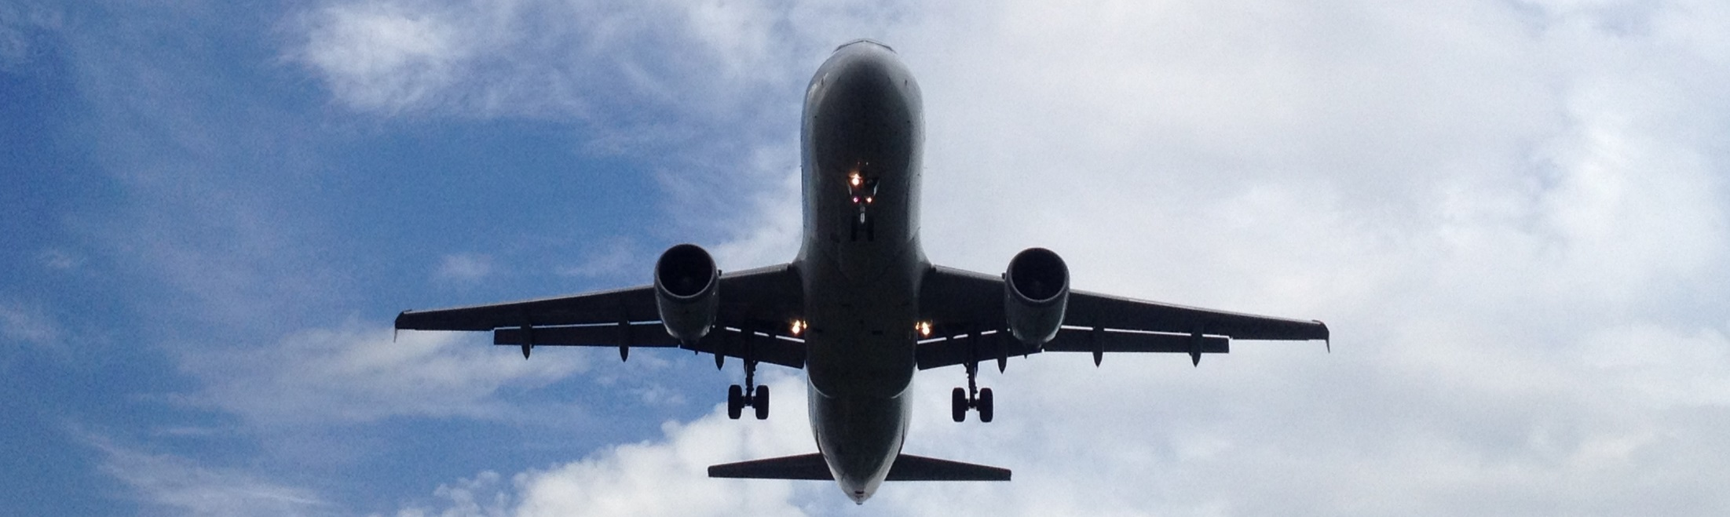
Flight delay prediction
Using machine learning to optimize claims expense forecast
Romain Barraud
25th September 2018

Slide 2

The challenge
Objective
Predict claim amount on flights due to delay
Context
Challenge proposed by T1
Approach
Exploratory analysis
Data cleaning
Feature engineering with addition of external data
Modelling
Deployment of an online model

Slide 3
1. The Dataset
899,114 records with 10 features
Very clean: only 4% of NULL values in Arrival (replaced by most frequent value)
Need to convert some types to decimal and categorical
2 features used for training but not available for future flights
delay_time → flight delay (numeric) with “Cancelled” flights (categorical) to isolate for better modelling during training
is_claim → dependent on delay_time (800 if delay > 3 hours or “Cancelled”)
flight_id | flight_no | Week | Departure | Arrival | Airline | std_hour | delay_time | flight_date | is_claim
1582499 | UO686 | 27 | HKG | KIX | UO | 10 | 0.4 | 01/07/2016 | 0
1582675 | CX753 | 27 | HKG | CGK | CX | 0 | -0.1 | 08/07/2015 | 0
1582680 | CX5974 | 19 | HKG | PEK | CX | 16 | Cancelled | 12/05/2014 | 800
1582681 | MH9185 | 23 | HKG | KUL | MH | 12 | 0.6 | 08/06/2016 | 0
1582892 | CX564 | 19 | HKG | TPE | CX | 13 | 3.7 | 12/05/2014 | 800
1582898 | CX611 | 2 | HKG | CMB | CX | 20 | 0.1 | 14/01/2015 | 0

Slide 4

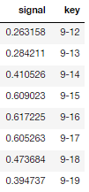

2. External data enrichment
Hong Kong bank holidays
Destination geographical data from an external csv file
latitude, longitude, country
Hong Kong to destination distance calculation
Typhoon predictions from online historical data
Online data from Hong Kong Observatory
50 years historical data
Based on date and typhoon strength
Typhoon daily probability
Month-Day
Probability (normalized)

Slide 5
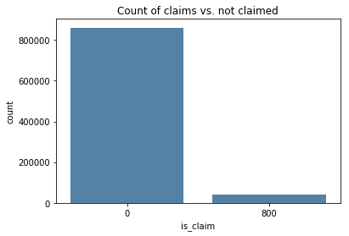
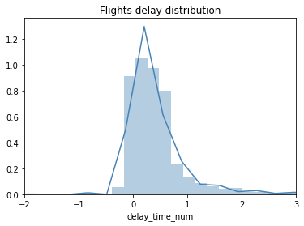
2.1 Exploratory analysis
Only 4.38% of the records lead to a claim.
Risk to over predict “no claim” during training
Delay distribution not far from normality
Sharp left tail cut (no flight arrives very early)
Long right tail (some flights do arrive late)

Slide 6
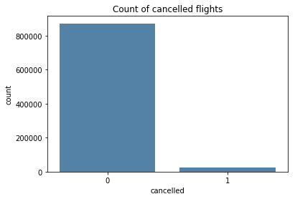
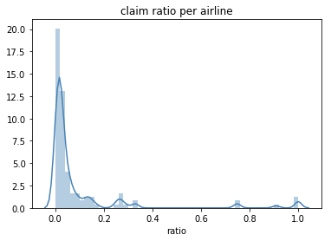
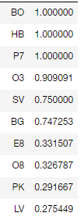
2.2 Exploratory analysis
Claim ratio per airline
2.86% of cancelled flight
→ Half of the claim!
Recurrent delays for some airlines
More than 74% for the top 6 ‘most late’ airlines!

Slide 7
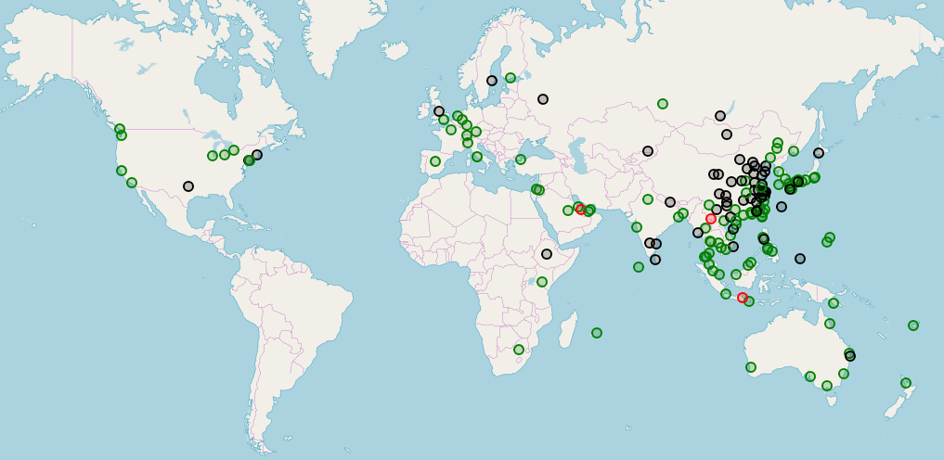
2.3 Exploratory analysis
Map view with dataset + external data providing destinations location and distance
Flights destination and average delay
Hong Kong mainly serves regional destinations
A few large airports have very high (red) mean delay
Mainland China tends towards more medium (black) delay
Southern Asia and long distance flights are rather on time
Delay
> 60 min
30-60 min
< 30 min

Slide 8
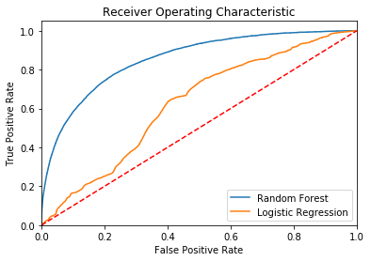
3.1 Modelling
2-step approach
Predict claim / not claim flights and get from model the event probability
Calculate optimal claim budget based on probability
1st phase
Model with Logistic Regression and Random Forest to handle large dimension space and get probability associated to claim / not claimed event
Random Forest performing best

Slide 9
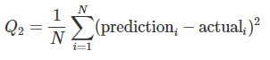
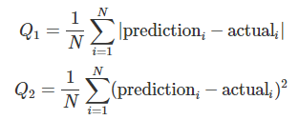

4.2 Modelling
2-step approach
Predict claim / not claim flights and get from model the event probability
Calculate optimal claim budget based on probability
Budget allocation from 2nd phase
2nd phase
Optimize mean Q1 + Q2 for each probability
Polynomial equation of degree 2
Allocate budget based on polynomial minimum
Model is ready!
Probability obtained from 1st phase
1
2
flight_id | flight_no | Week | Departure | Arrival | Airline | std_hour | flight_date | prob | budget
1582501 | CI7868 | 17 | HKG | TNN | CI | 11 | 23/04/2015 | 0.99 | 0.64
1582509 | KA5390 | 40 | HKG | PEK | KA | 9 | 05/10/2015 | 0.99 | 0.64
1582511 | NZ4851 | 10 | HKG | IST | NZ | 23 | 10/03/2015 | 0.99 | 0.64
1582512 | CX5626 | 51 | HKG | HGH | CX | 7 | 19/12/2015 | 0.98 | 1.71
1582575 | AY5837 | 50 | HKG | SIN | AY | 16 | 11/12/2014 | 1.00 | 0

Slide 10
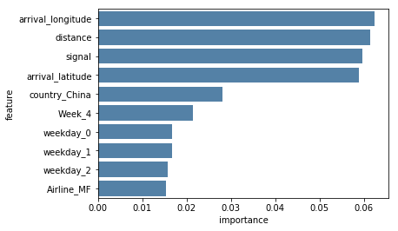
3.2 Final model feature analysis
Random Forest top features
Distance + latitude + longitude, (which determines uniquely a place, is a strong feature
China flights have regular delays as seen on the map
Week 4 has impact because... this is Chinese New Year!
The created signal probability has some power. Good job!
Performance on testing (unseen) dataset
Q1 | Q2 | Mean (Q1,Q2)
26.29 | 17973.74 | 9073.81

Slide 11


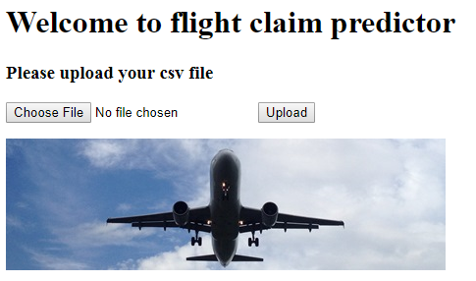
5. Try it!
Jupyter notebook
Run the entire notebook
Input your file name into the last cell
Get the result in the created output file
Online
Amazon AWS
Single VM Ubuntu-xenial-16.04-amd64-server
Go to 54.210.91.79
Upload your .csv file
Press Predict
Get your output file
Web app
Sample file you can use

Slide 12
6. Next steps
Addition of new external data
Weather forecast… but not free!
Add bank holidays of destinations
Model
Investigate further resampling to balance claimed and not claimed
Introduce time series to capture changes over time
Web app
Enhance architecture: more powerful instance, auto-scaling, load balancer and database to store the predictions made
Provide json (API-style) and csv file and live result for 1 choice

Slide 13
Thank you!
Have a nice flight

